Slide 1
Introduction to PCB design in KiCAD

Slide 2
Where to find these slides and other necessary files
https://github.com/pvikberg/PCB_lecture
Download these files now, some of them will be necessary later

Slide 3
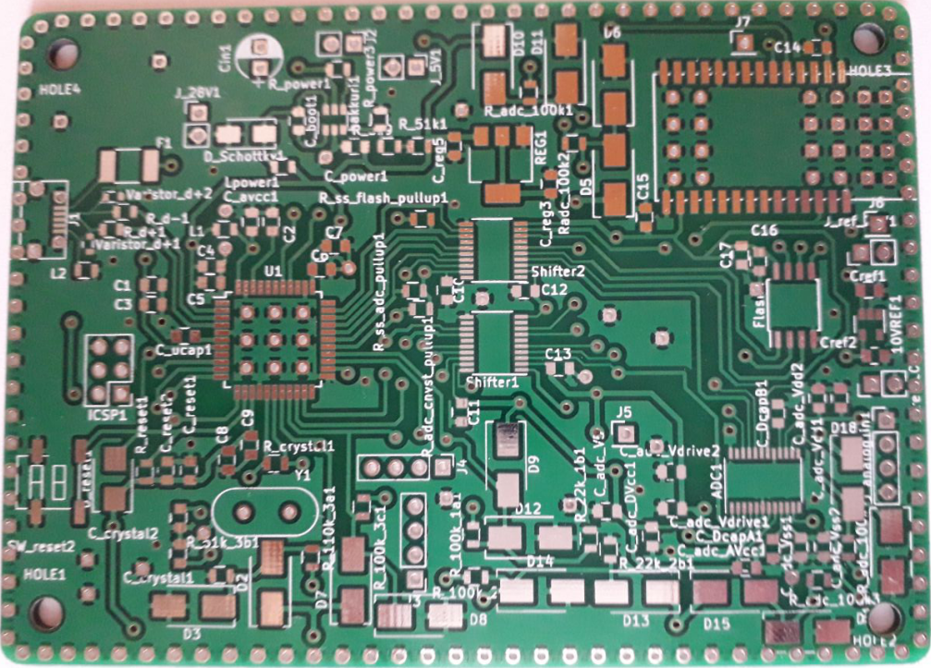
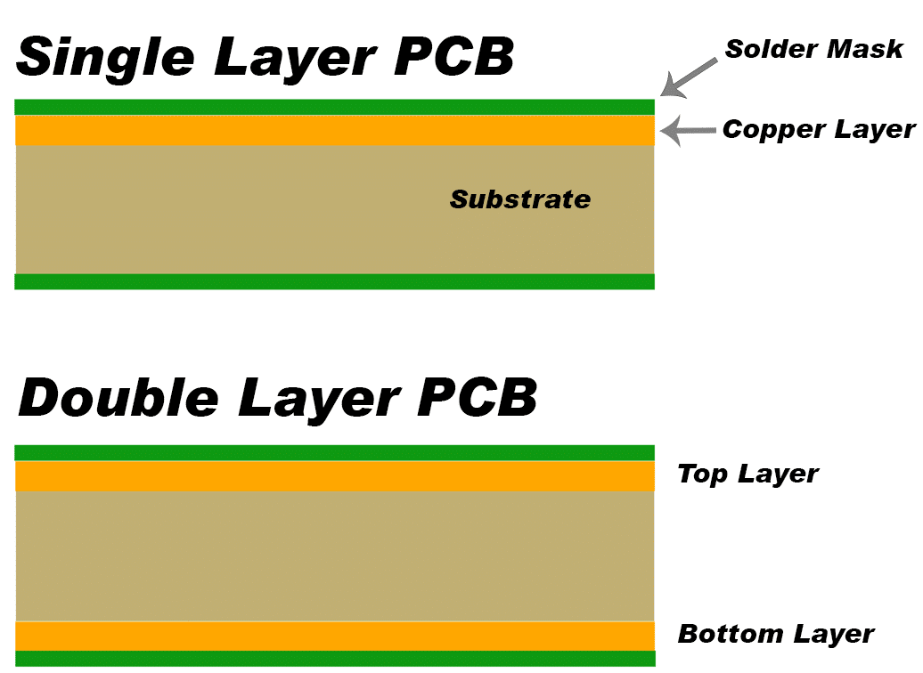
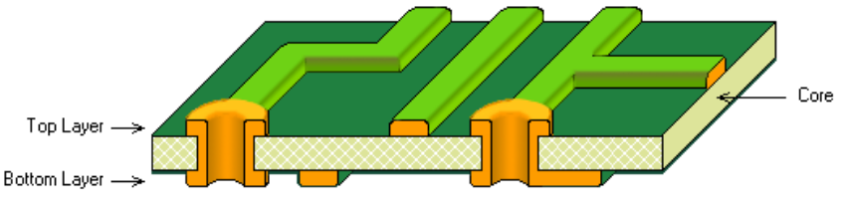
What is a PCB?
PCB = Printed Circuit Board
PCB is wiring:
Connects components to one another
Can be ordered from a factory
Or
Can be etched (corroded) in the workshop
Fast, more work, chance of failure

Slide 4
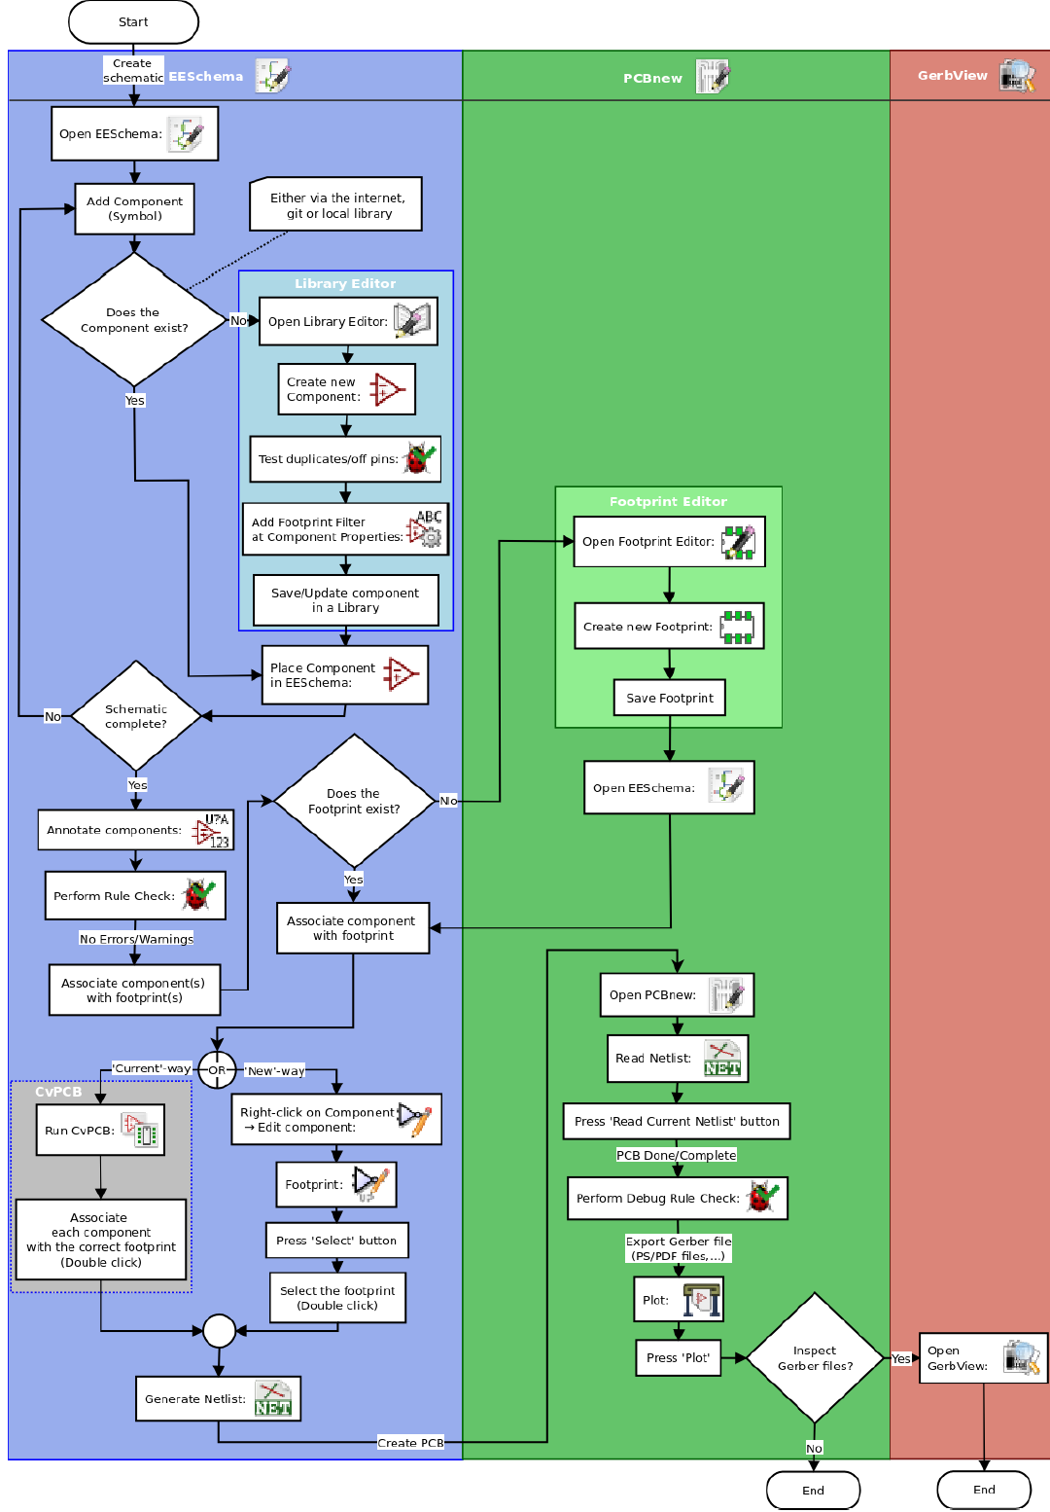
Workflow
1: Decide what is to be done
2: Choose components
Use datasheets when doing this
Make sure components are compatible
3: Open KiCAD and start a new project
4: Add the components and make the wirings in EESchema
Use datasheets to find correct pins
5: Associate footprints to components and create a netlist
6: Open PCBnew, read the netlist and set design rules
7: Place components , wirings, borders, filled areas etc.
8: Create files needed to manufacture PCB
In workshop: plot the pdf-files (MIRROR THE FRONT COPPER IMAGE)
Ordered from a factory: plot gerbers and drill file

Slide 5
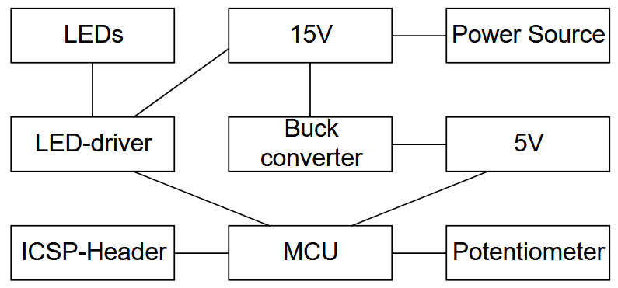
1. Decide what is to be done
In this example, we wish to use a potentiometer to control the brightness of 4 blue LEDs with a LED-driver and a microcontroller (MCU)
A very suboptimal (stupid) solution, but should do as an excercise
Components
needed:
Potentiometer
4 LEDs
LED-driver
MCU
Buck converter

Slide 6
2. Choosing the components
Time consuming
See what the workshop has stocked
Order online:
Mouser, Digikey, Farnell etc…
Hint: try googling e.g. ”led driver farnell” to find the correct category
With experience, one could search manufacturer sites (e.g. Texas instruments)
Almost every component has a datasheet that provides a detailed description of the component
When ordering online, pay very close attention to the datasheet and make decision to purchase based on the datasheet
Some important criteria: footprint, casing and soldering difficulty
For the purproses of this demo, components have already been chosen

Slide 7
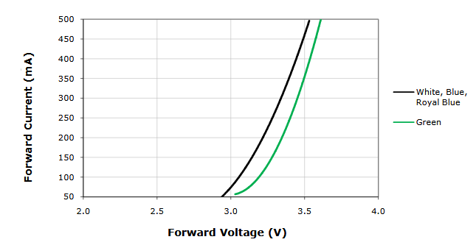
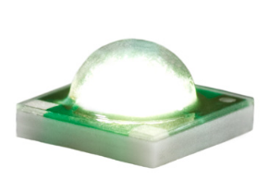
2. Choosing the components: LEDs
From the datasheet:
Forward voltage: 3.35V
Current: ~350mA
XPCBLU-L1-0000-00W02 - LED, HB, BLUE, 23.5L
http://fi.farnell.com/cree/xpcblu-l1-0000-00w02/led-hb-blue-23-5lm/dp/2419727

Slide 8
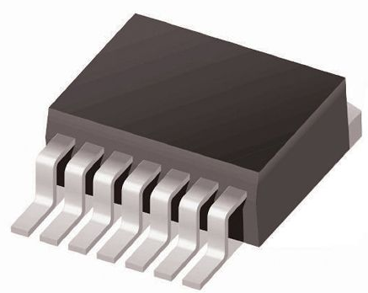
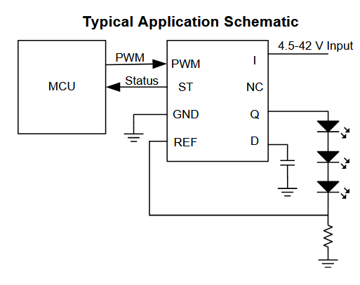
2. Choosing the components LED-driver
Led brightness controlled by constant-current PWM-signal
Pulse Width Modulated (PWM) voltage input
controls a constant-current PWM output->
MCU PWM used to control this LED-driver
Constant current strength chosen with
a reference resistor->
Texas Instruments, TL4242-Q1 Adjustable LED Driver
http://www.ti.com/lit/ds/symlink/tl4242-q1.pdf

Slide 9
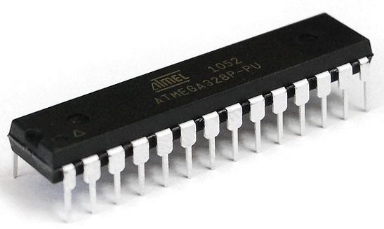
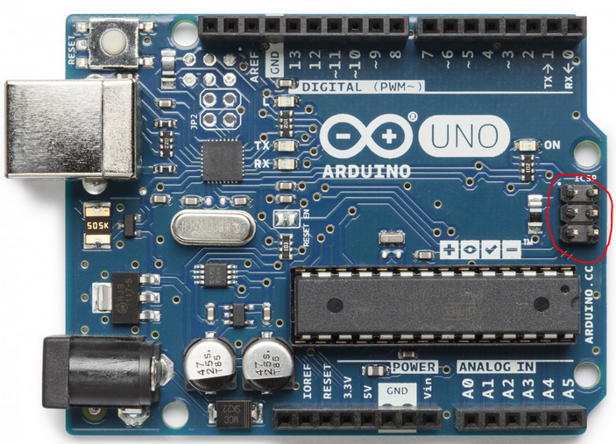
2. Choosing the components: MCU
From the workshop: Atmel-328P: the same as in Arduino UNO
Study the Arduino UNO schematic to find
out what additional components are needed
ICSP-header needed to program this with an
Arduino UNO

Slide 10
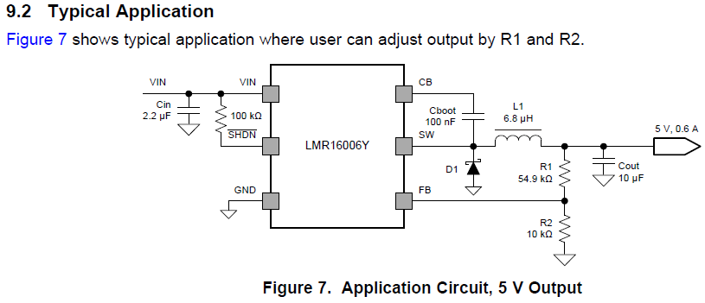
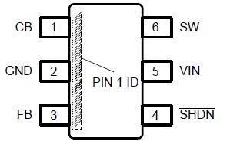
2. Choosing the components: Buck Converter
The input voltage (15V) is too high for the MCU, but ut is what the LED-driver needs to drive 4 LEDS (3.5V each)
-> give the MCU 5V with a buck converter
Datasheets shows a
typical application,
just what we need ->
LMR16006Y-Q1 SIMPLE SWITCHER
https://eu.mouser.com/ProductDetail/Texas-Instruments/LMR16006YQDDCRQ1?qs=sGAEpiMZZMsMIqGZiACxIYznHxQwyfA9giA2KvrC9rNu6yNWUn0Fsg%3d%3d

Slide 11
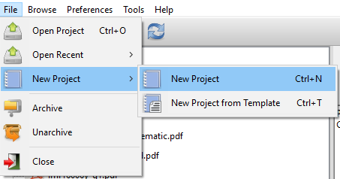
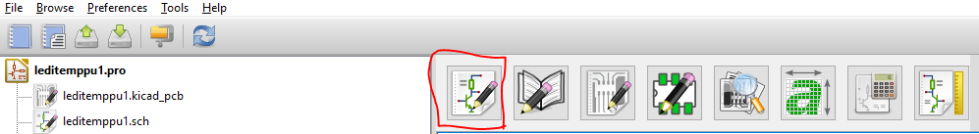
3. Open KiCAD and start new project
The following parts are explained more generally in ”Getting Started in KiCAD” http://docs.kicadpcb.org/stable/en/getting_started_in_kicad.pdf
The KiCAD installer can be found from: http://kicad-pcb.org/download/
Open KiCAD and start new project, name it however you want
Then, open EESchema

Slide 12
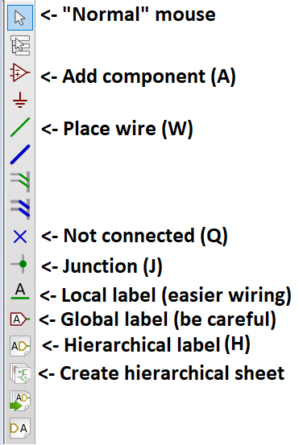
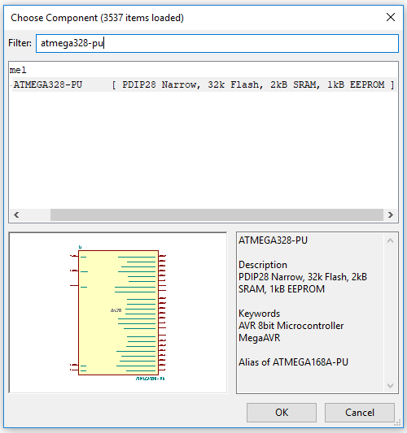
4. Add the components, Using EESchema
Move mouse to the big area, and press A Some explanations
Search for ’atmega328-pu’, press ok
Then place the
component in the
lower right corner
of the big area
Hower mouse over
a component and press
M to move it, R to rotate,
click to place

Slide 13
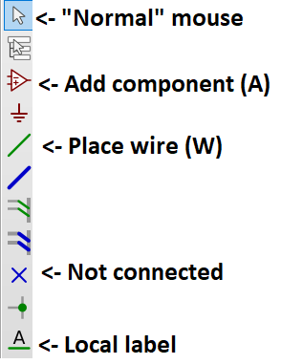
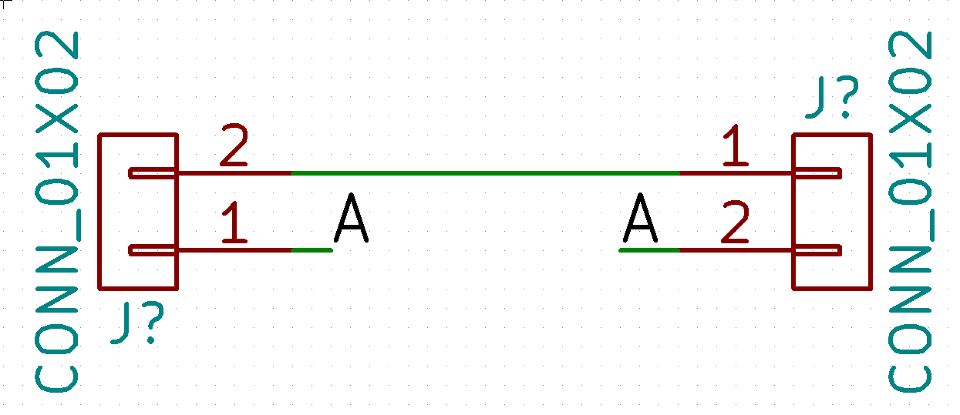
4. Add the components, Using EESchema
Wires indicate which pins are connected
Local labels can be used instead of wires, as below
Makes rewiring easier
If a pin is not connected to anything,
place a ’not connected’ marker on it

Slide 14
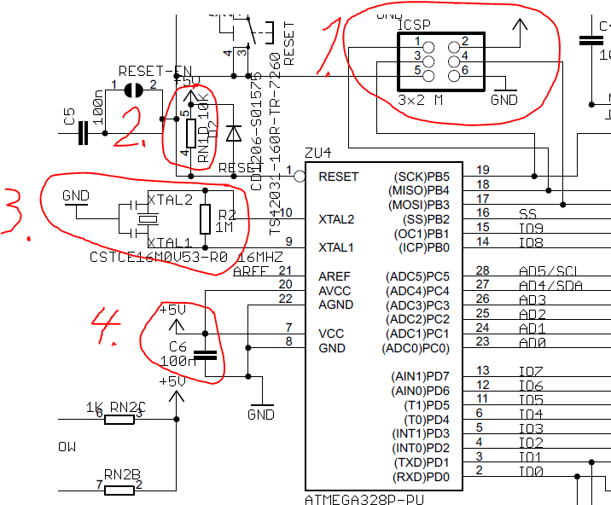
4. Add the components, reading datasheets
Let’s look at the Arduino UNO schematic to see what we need at least
1: ICSP-header
2: A resistor between RESET & 5V
3: A 16MHz crystal, 2 22pF
capacitators and a 1M resistor
4: A 100nF capacitator

Slide 15
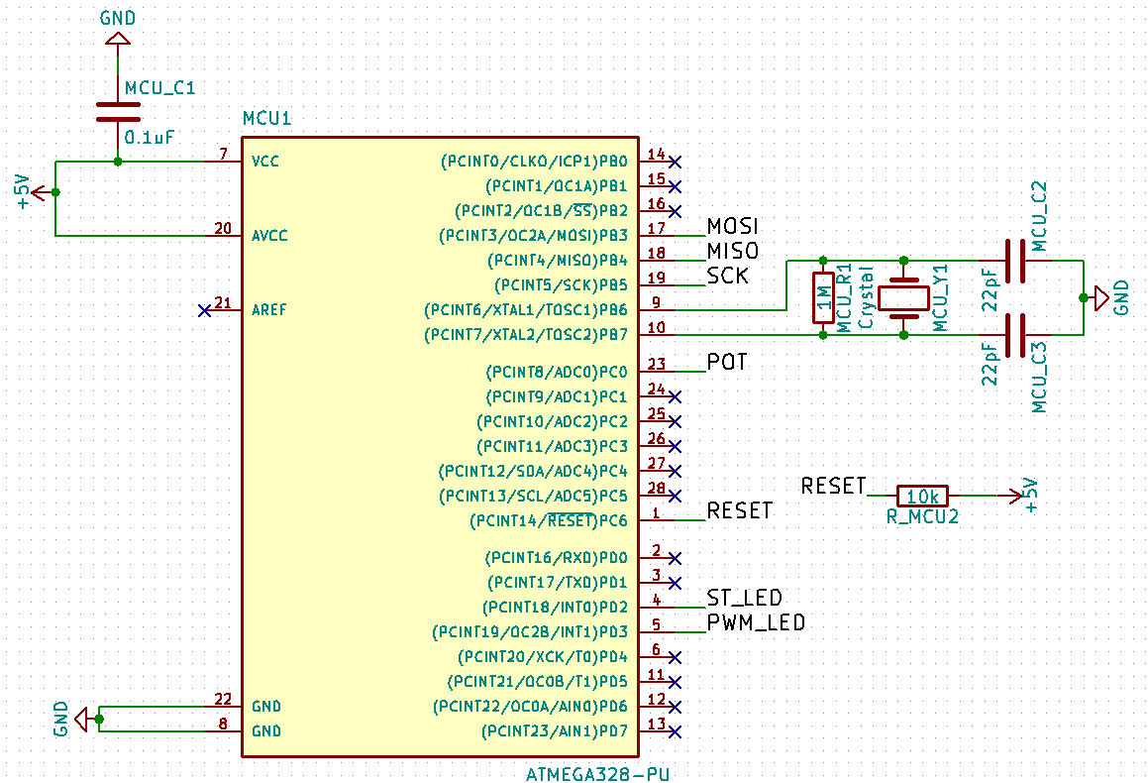
4. Add the components, reading datasheets
Press A to add a component, use the search bar to find right ones
R: resistor
C: capacitator
Crystal: crystal
GND: ground
5V: +5V
To move a component after placing,
hower mouser over it and press M
To edit values, hower and press E
Add components, wires, labels…
like this->
Remember to annotate (name) the
components and add values

Slide 16
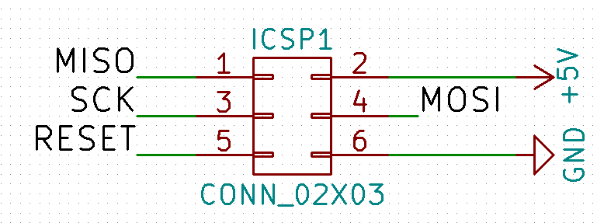
4. Add the components, reading datasheets
Now, let’s add the ICSP-header
Press A and search for ’conn_02x03’
Add the connector, and then place wires and labels like this:
Remember to annotate the connector

Slide 17
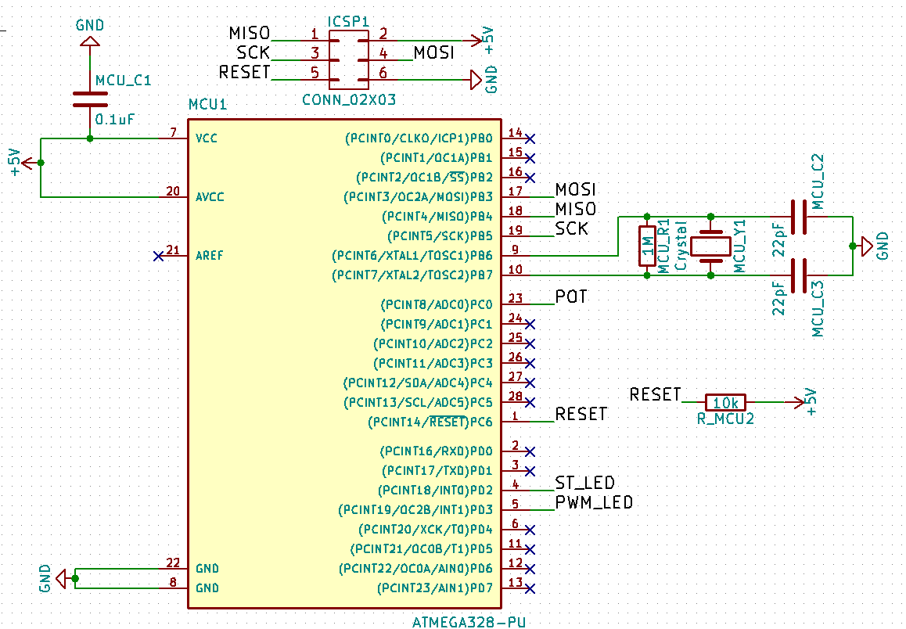
4. Add the components, reading datasheets
We should now have something that resembles the UNO schematic

Slide 18
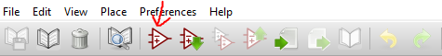
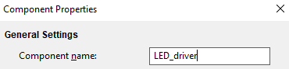
4. Add the components, creating components
Often, KiCAD does not have the component we intend to use, so we need to create new ones
Lets create a LED-driver
1:
2:
3:
Note: usually when creating components one should include the component code in the name, in this case ”TL4242-Q1”

Slide 19
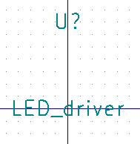
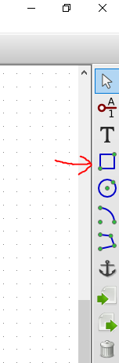
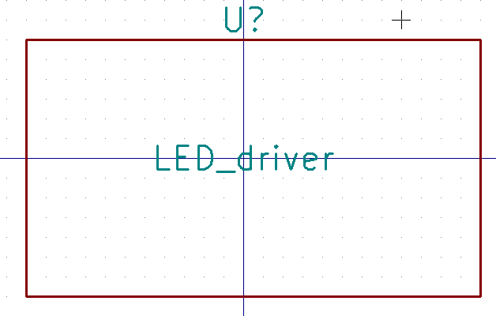
4. Add the components, creating components
Move the texts (M): Then create a rectangle:
Draw the rectangle like this:

Slide 20
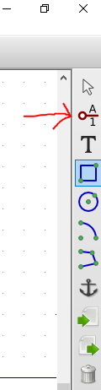
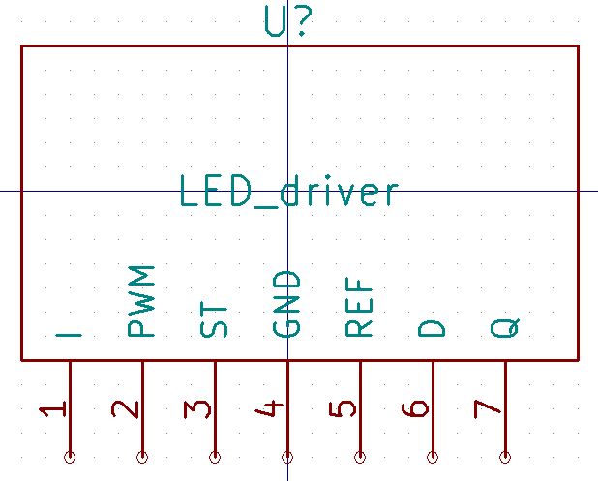
4. Add the components, creating components
Then Create the pins: And place and name them like this:

Slide 21
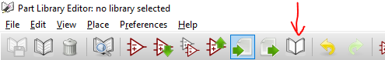
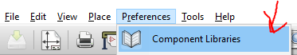
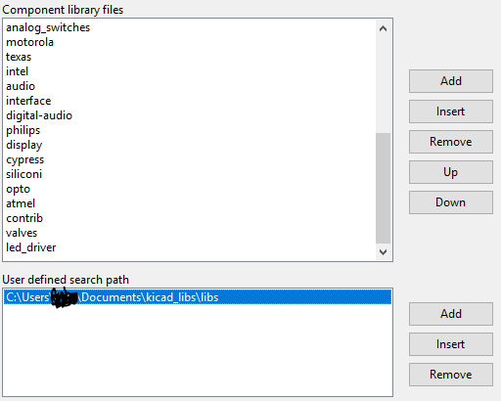
4. Add the components, creating components
Save the created component:
Go back to EESchema
Preferences-> Component libraries
Add folder of created component
to user defined search path
Add created library file in upper part

Slide 22
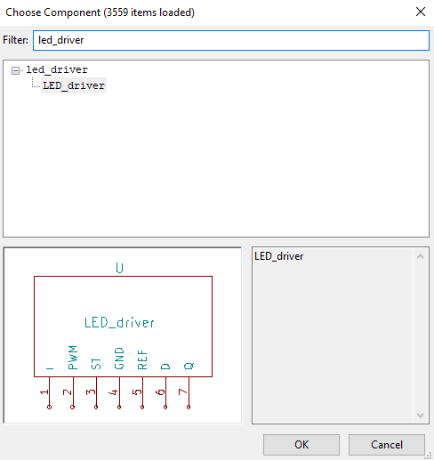
4. Add the components, creating components
Add the new component in the big area
Then, let’s look at the datasheet

Slide 23
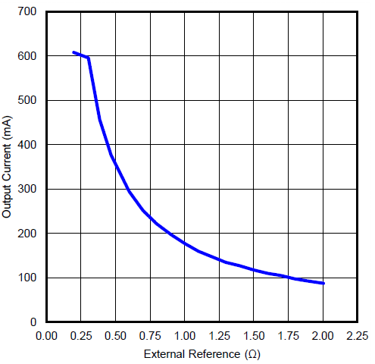
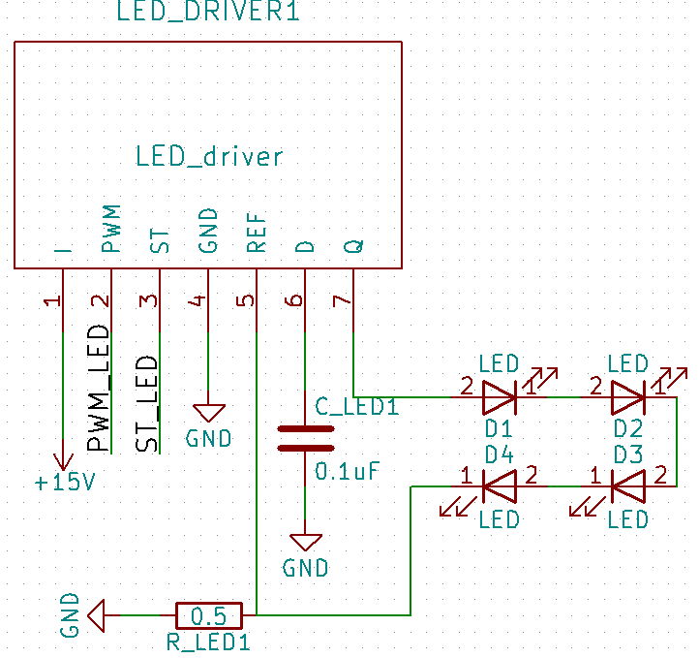
4. Add the components, adding the LED-driver and the leds
Desired current: 350mA -> 0.5 Ohm

Slide 24
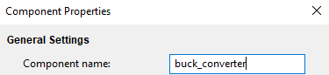
4. Add the components, create the buck converter
Like the LED-driver, the buck converter needs to be created
1:
2:
3:

Slide 25
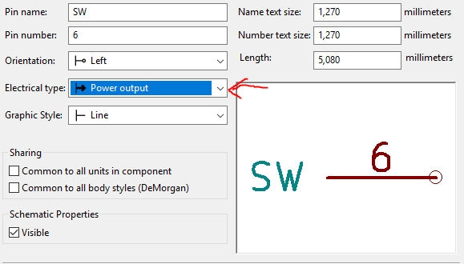
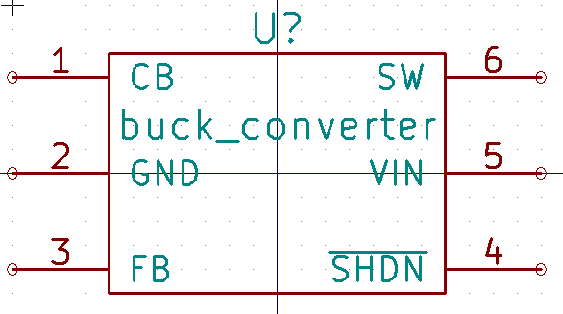
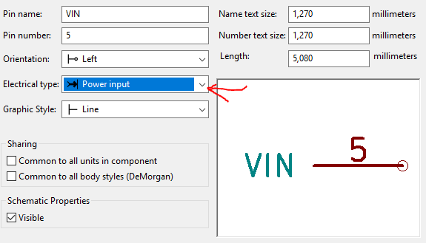
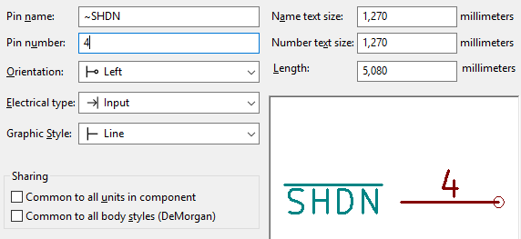
4. Add the components, create the buck converter

Slide 26
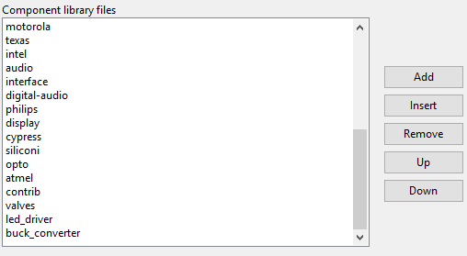
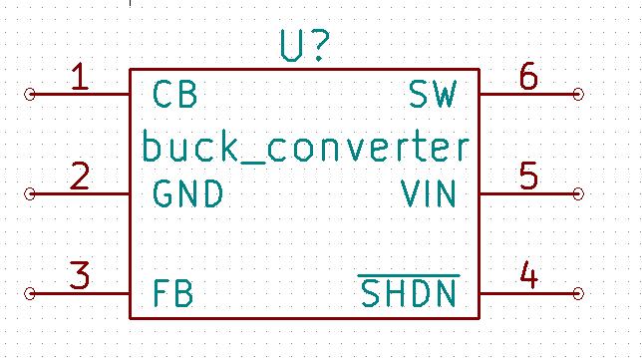
4. Add the components, create the buck converter

Slide 27
4. Add the components, buck converter datasheet
Copy and paste the typical application
You can find the coil in the component browser using ’L’
The diode is a Schottky diode

Slide 28
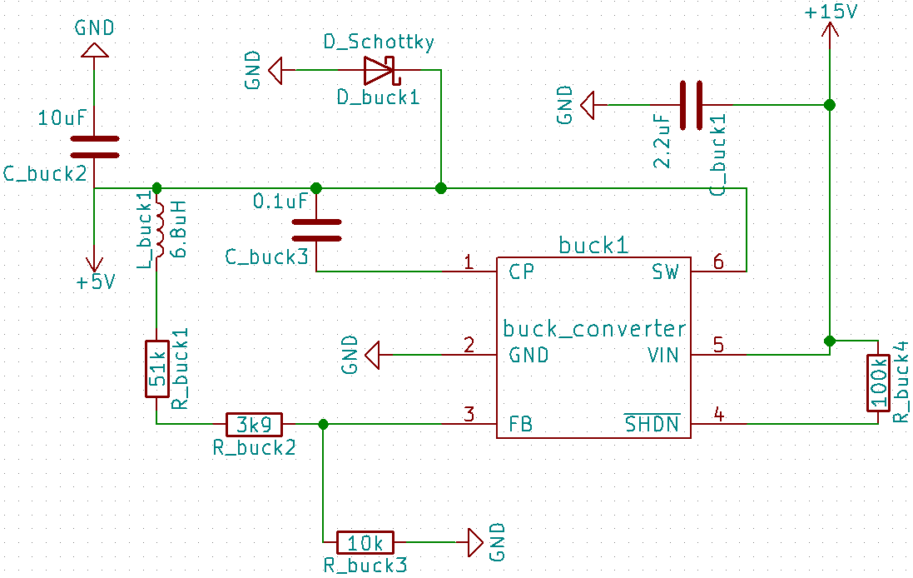
4. Add the components, buck converter datasheet
The 54.9 Ohm resistor broken into 2 resistors because the workshop has 51k and 3.9k Ohm resistors

Slide 29
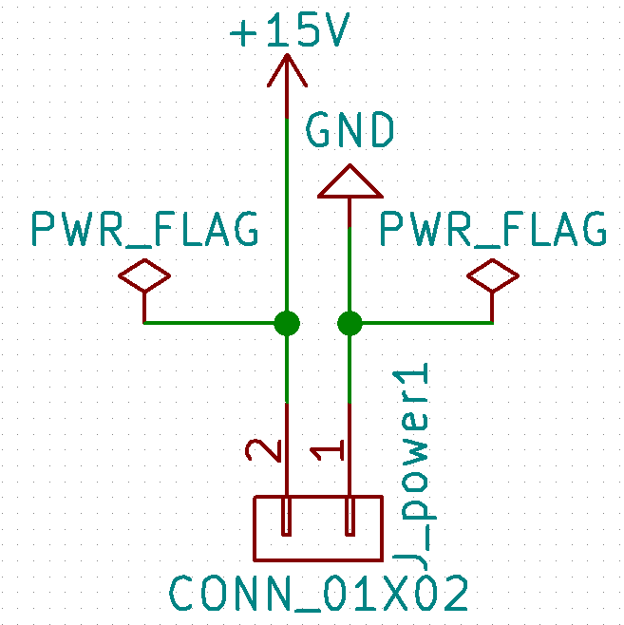
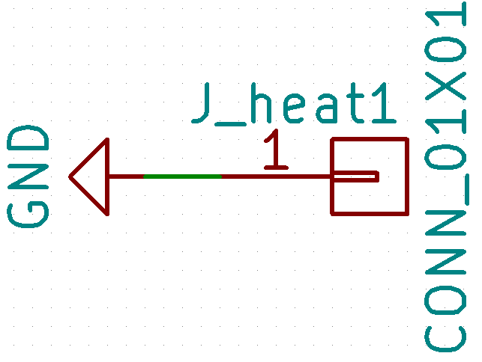
4. Add the components, power pins and heat via
System has to get power somewhere, add power pins
Also add power flags to both pins
This tell KiCAD where the power
comes from
Also add a heat via

Slide 30
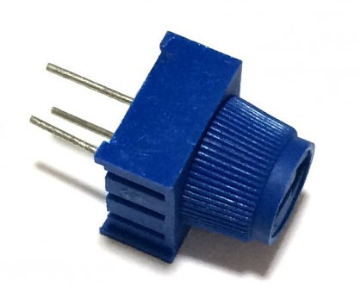
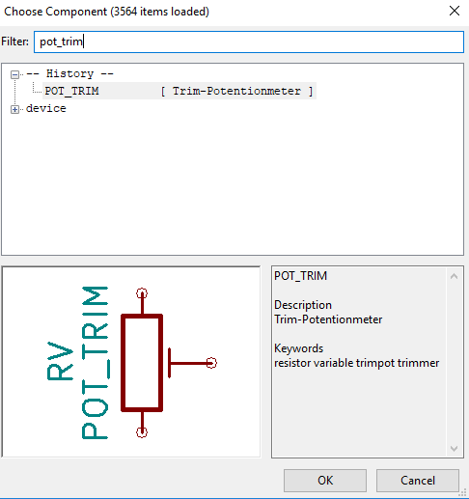
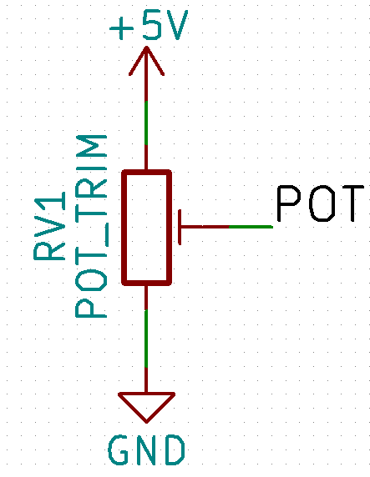
4. Add the components, the potentiometer
Found in the workshop
Add component (A), POT_TRIM

Slide 31
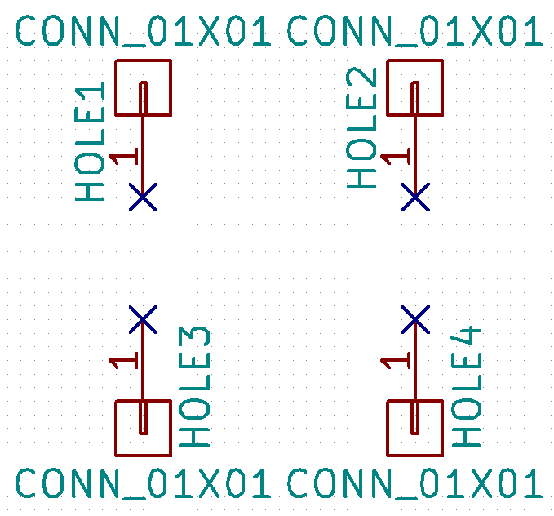
4. Add the components, mounting holes
Create 4 mounting holes for the corners

Slide 32

4. Add the components, check for errors
After making the wirings, you should always check for errors
If done correctly, you shouldn’t have errors

Slide 33



4. Add the components, create a new footprint
Let’s create a new footprint for the potentiometer
Create a new folder inside project directory called e.g.
’potentio_1.pretty’

Slide 34




4. Add the components, create a new footprint
1: 3:
2: 4:

Slide 35



4. Add the components, create a new footprint
Right click, select grid 2.54mm ->
Add 3 pads

Slide 36

4. Add the components, create a new footprint
Save the footprint
Close the window and return to EESchema
Open CvPcb to associate footprints to components
Press Annotate and Ok
Wait…

Slide 37




5. Associate footprints to components, importing libraries
It is possible that the school computers do not have the libraries needed, import the libraries downloaded from github

Slide 38

5. Associate footprints to components
Now, tell KiCAD what is each component’s footprint
Datasheets and shop product pages of internet suppliers (Mouser etc…) may prove useful

Slide 39

5. Associate footprints to components, Spoiler

Slide 40

5. Associate footprints to components, create netlist
Remember to save your changes
Close this window, return to main window and generate netlist
IMPORTANT! Save the progress you have made.

Slide 41
Intermission, continues tomorrow…
Today we told KiCAD what components are to be placed on the PCB, how they should be connected, and what their footprints are
Tomorrow we shall draw where the components and wires will be physically on the board

Slide 42

Recap, where we are, and intermission
1: Decide what is to be done
2: Choose components
Use datasheets when doing this
Make sure components are compatible
3: Open KiCAD and start a new project
4: Add the components and make the wirings in EESchema
Use datasheets to find correct pins
5: Associate footprints to components and create a netlist
<- We are here
6: Open PCBnew, read the netlist and set design rules
7: Place components , wirings, borders, filled areas etc.
8: Create files needed to manufacture PCB
In workshop: plot the pdf-files (MIRROR THE FRONT COPPER IMAGE)
Ordered from a factory: plot gerbers and drill file
See you tomorrow!

Slide 43
Welcome back!
1: Decide what is to be done
2: Choose components
Use datasheets when doing this
Make sure components are compatible
3: Open KiCAD and start a new project
4: Add the components and make the wirings in EESchema
Use datasheets to find correct pins
5: Associate footprints to components and create a netlist
<- We are here
6: Open PCBnew, read the netlist and set design rules
7: Place components , wirings, borders, filled areas etc.
8: Create files needed to manufacture PCB
In workshop: plot the pdf-files (MIRROR THE FRONT COPPER IMAGE)
Ordered from a factory: plot gerbers and drill file

Slide 44

6. Open PCBnew
Open KiCAD
Open EESchema
Then open PCBnew
Wait…

Slide 45


6. PCBnew, set design rules

Slide 46

6. PCBnew, read netlist

Slide 47

6. PCBnew spread out all components
Now your components are on to of one another, time to spread them out…
Right click next to the components, and…

Slide 48

6. PCBnew, spreaded out components
Now, you should see all the components spread out

Slide 49



6. PCBnew, verify footprints manually
To verify that we have chosen the correct footprints, let’s print all the footprints on paper and put the components on the paper
Print the plotted pdf on a school printer
Hint: choose ”Actual size” when printing

Slide 50

6. PCBnew, verify footprints manually
Your pdf should look something like this:
The black parts are the
footprints

Slide 51

6. Modifying footprints
If a footprint is completely wrong, you should:
1: Return to EESchema and open CvPcb where the footprint were chosen
2: Choose a better footprint
3: Save changes in CvPcb, and generate a new netlist in EESchema
4: Return to PCBnew, delete the bad footprint, and read the netlist
5: Spread out all the footprints and see if you have had better luck
If only minor modifications are needed, then right click the footprint, and:

Slide 52

6. Modifying footprints, heat via
Let’s modify the heat via, right click the footprint, and:
First, lets remove the texts,
Right click on the text -> Edit Text
Remove all text from value box

Slide 53





6. Modifying footprints, heat via
Then, lets remove the lines (delete):
Then right click on the pad: -> edit pad
Then change it to circular, and press ok
Finally, update the footprint on the board:
You can now close the footprint editor

Slide 54

7. Moving footprints
Footprints are moved by howering the mouse over them, and pressing M, and can be rotated in 90-degree increments by pressing R, and placed where desired by clicking
You can change the movement precision by choosing a different grid by right clicking on the background and choosing a different grid

Slide 55

7. Drawing the borders of the board
Let’s start by drawing the borders
Choose the Edge.Cuts layer:

Slide 56


7. Drawing the borders of the board
Then choose the tool to draw lines ->
Now, draw some rectangular borders
Draw the box big enough so all the components and wirings will fit

Slide 57


7. Moving the footprints
First, enable ”rats nests”
Now when you are moving a component, you can see where it should be connected to

Slide 58

7. Moving the footprints, Spoiler
Figuring out where components should be placed
is a time-consuming task
To save time during this demo, the board was drawn big, and a suggestion
is provided
Footprints are moved by howering the mouse over them, and pressing M, and can be rotated in 90-degree increments by pressing R, and placed where desired by clicking
Move the components as follows
1: Move the microcontroller and the components related to it (MCU)
to the lower right corner
2: Move the buck converter and the components related to it (buck)
to the upper right corner
3: Move the rest of the parts (LED-driver and LEDs) to the left

Slide 59

7. Moving the footprints, buck converter
First, move the buck converter components like this

Slide 60

7. Drawing the wiring
Now its time to draw the wires between components
Try to avoid making sharp 90 degree turns if possible: they may pick up radio interference
Try to have thick wires when possible: low resistance
Wires can be placed on both sides of the board, different sides are connected via vias

Slide 61


7. Drawing the wiring
Sometimes it can be difficult to connect wires without intersecting, sometimes a jumper is a possibility
In some cases a piece of thin wire may be used
A zero-Ohm smd resistor can be also used like a ”bridge”
Try to avoid these tricks if possible

Slide 62


7. Drawing the wiring
1: 2: Right click and choose 2mm track width:
3: Choose to start drawing wires on the backside

Slide 63


7. Drawing the wiring
1: Click the upper pin of the round capacitor 2: Double click the
lower connector pin
These two pins are now connected

Slide 64



7. Drawing the wiring
1: Click on the same round capacitator pin, move the mouse a bit left and press V, this creates a via here
2: Then right click and change the track width to 0.7
3:Finally, double click on the resistor upper pin

Slide 65

7. Drawing the wiring, buck converter
Lets draw the other buck converter wires
Hint: start the wires from the 6-footed converter

Slide 66



7. Drawing the wiring, the microcontroller
Let’s move the microcontroller et al. a bit closer to the buck converter, lasso them

Slide 67

7. Drawing the wiring, the microcontroller, Spoiler,
Principle:
Red wires are on the
frontside, green on the
backside
Connect to holes
(yellow) from the back
Hint: you can move
the components
around for a bit

Slide 68

7. Drawing the wiring, the LED-driver and leds
Let’s move the
LED-driver et al.
a bit closer:

Slide 69

7. Drawing the wiring, the LED-driver and LEDS, Spoiler
Lets wire them up

Slide 70


7. Drawing the wiring, heat vias
The LED-driver might heat, so let’s put heat up vias underneath it just in case
Right click it, and create a duplicate
Right click the duplicete,
and create an array of them

Slide 71

7. Drawing the wiring, heat vias
Then, move the array underneath the LED-driver

Slide 72


7. Drawing the wiring, resizing the board
As we can see, the area we chose at the beginning is too large
Time to delete the old borders and draw new with Edge.Cuts…
--------------------->

Slide 73


7. Drawing the wiring, adding fills
We never connected the ground pins because we can simply fill the empty areas with ground plane
And then click on the corner of the board, and choose:

Slide 74

7. Drawing the wiring, adding fills
Include the whole board in the area, and press B
We can see that the empy areas are
filled with copper
Do the same thing, but for backside

Slide 75


7. Drawing the wiring, adding fills
Looks good, but now we cannot see things properly, press CTRL + B to remove fills temporarily
Its usually not a good idea have large unbroken areas of filling, so let’s add some additional heat vias in the ”empty” areas
Paste the duplicate many copies of the heat via
in various places
Hint: CTRL + D

Slide 76

7. Drawing the wiring, adding fills
Start adding duplicates in empty areas
Press B to add fills

Slide 77

7. Drawing the wiring, adding mounting holes
Finally, move the mounting holes to the corners of the board

Slide 78



7. Drawing the wiring, adding fills
To enable you to see clearer, you can choose which layers you want to see
That’s better ->
You can also choose if you want to see fills on the left

Slide 79

7. Drawing the wiring, checking errors
Finally, let’s see if we have made any errors

Slide 80

8. Create files needed to manufacture

Slide 81


8. Create files needed to manufacture, order online
Generate gerbers: (check website e.g. elecrow for specifics)
Front and back copper layers
Front and back silk screens
Front and back masks
Mechanical layer (Edge.Cuts)
Also generate a drill file
Some Places to order (non-exhaustive):
Elecrow
Seeed
Oshpark
Try googling and asking…
Great variance in price

Slide 82

8. Create files needed to manufacture, in the workshop
Plot the copper layer pdfs
REMEMBER TO MIRROR THE FRONT LAYER, BUT NOT THE BACK LAYER
Press plot, use the printer in the
workshop to print the layers on
projector slides
Use the slides as I’ll explain now…
If necessary, I’ll explain again later
and will help you make the first PCB
in the workshop

Slide 83
The end
Questions?
Comments?
Other?

